Slide 1
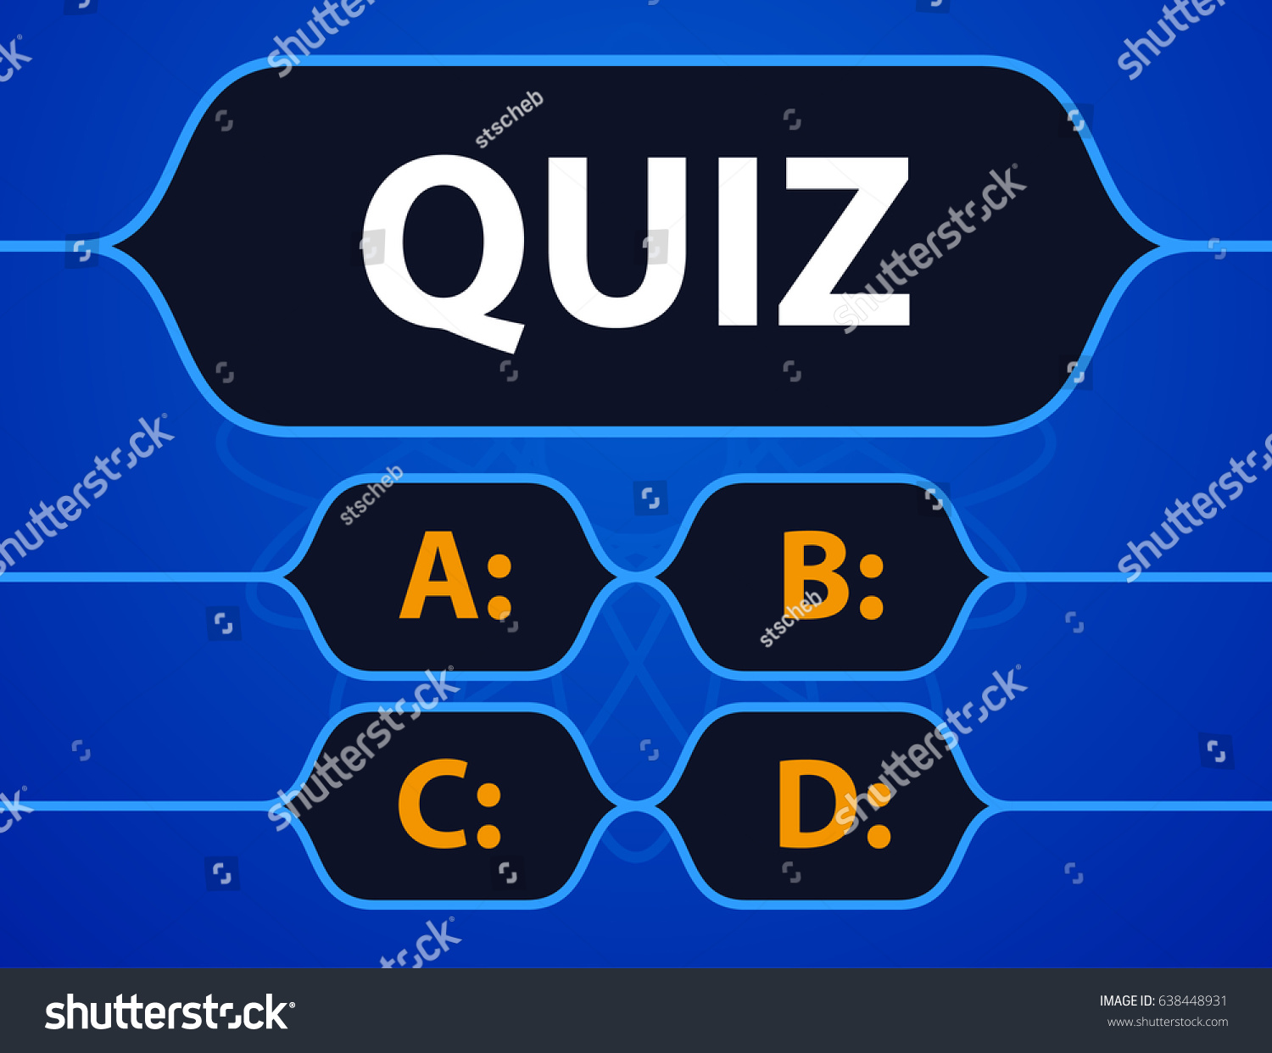

Slide 2
Who invented the quiz?
Oprah Winfrey
Steven Spielberg
George clooney
Richard Daly

Slide 3
Who among the following are the Founders of Social Networking Site: “twitter” ?
Chris Hughes, Dustin Moskovitz, Eduardo Saverin, Mark Zuckerberg
Larry Page, Sergey Brin
Biz Stone, Evan Williams, Noah Glass, Jack Dorsey
Jawed Karim, Chad Hurley, Steve Chen

Slide 4
In which year Microsoft was founded ?
1970
1974
1975
1976

Slide 5
In computers, what is the function of Kernel?
Holding the chip in place
Communication between hardware and software components
Maintaining Computer File System
Maintaining Software configuration

Slide 6
Which of the following memory medium is not used as main memory system?
Magnetic core
Semiconductor
Magnetic tape
Both semiconductor and magnetic tape

Slide 7
What is the full form of DELL ?
DIGITAL ELECTRONICS LINK LIBRARY
DISK ELECTRONICS LIBRARY LINK
DIGITAL ELECTRIC LINK LIBRARY
DATA ELECTRONICS LIST LIBRARY

Slide 8
What is the full form of ULSI
ULTRA LARGE SCALE INTEGRATION
UPLINK LEVEL SYSTEM IDENTIFICATION
ULTRA LARGE SCALAR INTERFACE
UNIVERSAL LOCAL SCALE INTEGRATION

Slide 9
What is the full form of WINDOWS
WIDE INTERACTIVE NETWORKING DEVELOPED FOR ORIENTED WORK SOLUTION
WIDESCREEN INTRA NETWORK DEVELOPMENT FOR OFFICIAL WORKING SOLUTION
WIDE-BAND INTERNATIONAL NETWORK DEVELOPING FOR OPERATING WORKING SYSTEM
WIDE INTERACTIVE NETWORK DEVELOPMENT FOR OFFICE WORK SOLUTION

Slide 10
What is the full form of VIRUS
VIRTUAL INTEGRATION RESOURCES UPGRADING SYSTEM
VITAL INFORMATION RESOURCES UNDER SIEGE
VIRAL INFORMATION RESPONCE UPLINK SOURCE
VITAL INTEGRATION RESOURCES UNINTERRUPTIBLE SIEGE

Slide 11
What is the full form of IMEI
INTERNATIONAL MACHINE EQUIPMENT IDENTIFICATION
INTEGRATED MODULE EQUIPMENT IDENTITY
INTERNATIONAL MOBILE EQUIPMENT IDENTITY
INTERMEDIATE MEMORY EQUIPMENT IDENTIFICATION

Slide 12
Programs designed to perform specific tasks is known as______?
system software
application software
utility programs
operating system

Slide 13
Computer operators
writes computer programs for specific problems
operate the device which input and output data from the computer
normally require a college degree in computer science
all of the above

Slide 14
What was the expected feature of fifth generation computers when Japan started FGCS?
Operating Systems
Parallel Processing
ULSI
None of above

Slide 15
The storage subsystem in a microcomputer consists mainly of or media with varying capacities
Memory or video
Magnetic or optical
Optical or memory
Video or magnetic

Slide 16
Which of the following is not anti-viruses software?
NAV
F-Prot
Oracle
McAfee

Slide 17
Which of the following is not input unit device?
scanner
camera
plotter
digitizer

Slide 18
Which of the following require large computers memory?
Imaging
Graphics
Voice
All of Above

Slide 19
The first machine to successfully perform a long series of arithmetic and logical operations was:
ENIAC
Mark-I
Analytic Engine
UNIVAC-1

Slide 20
Which one is the largest space?
kilobyte
petabyte
terabyte
gigabyte

Slide 21
FORTRAN programming language is more suitable for
Business Applications
Marketing Applications
Scientific Applications
None of the above

Slide 22
Analog computer works on the supply of
Continuous electrical pulses
Electrical pulses but not continuous
Magnetic strength
None of the above

Slide 23
An error in software or hardware is called a bug. What is the alternative computer jargon for it?
Leech
Squid
Slug
Glitch

Slide 24
What is the 1st internet provider country in the world?
USA
UK
UAE
India

Slide 25
What is the 1st 32bit microprocessor?
8085
8086
80386
80586

Slide 26
In which year C language was developed?
1970
1971
1972
1973

Slide 27
In the full form of BCCI what is the 2nd C stands for?
Cricket
Control
Council
Country

Slide 28
How many number of keys are available in a general numeric keyboard?
100-103
101-104
102-105
103-106

Slide 29
How many process can execute at a time in LINUX operating system?
15213
65535
16834
17431

Slide 30
In a 64bit processor how many number of address bus are present?
32
64
16
128

Slide 31
In adhar card how many digits is the adhar number?
10
11
12
16

Slide 32
What is the both input & output device?
Xerox machine
Printer
Scanner
None of the above

Slide 33
What is the default file system of the computer hard disk?
FAT
FAT 32
NTFS
All of the above

Slide 34
What is the 1st microprocessor?
4040
4004
8085
8086

Slide 35
In the ipv4 addressing format the number of networks allowed under Class C address is
1024
128
2097152
16777216

Slide 36
The amount of ROM needed to implement a 4bit multiplayer is
64 bits
128 bits
1 Kbits
2 Kbits

Slide 37
The protocol data unit(PDU) for the application layer in the internet stack is
Segment
Datagram
Message
frame

Slide 38
A process execute the code Fork (); Fork(); Fork(); The total number of child process created is
3
4
7
8

Slide 39
Which among the following option is meaning of the word MITIGATE
Diminish
Divulge
Dedicate
Denote

Slide 40
Which company produces HTC mobiles?
American company
Chinese company
Taiwanese company
Canadian company

Slide 41
Hp laptop produces in which country?
Japan
China
America
Korea

Slide 42
Google Company is located in which city of India?
Bengaluru
Chennai
Hyderabad
Delhi

Slide 43
Which of the following sentence is true?
Program and process both are static
Program and process both are dynamic
Program is static and process is dynamic
Program is dynamic and process is static

Slide 44
Who is the minister of communication and information technology in india?
Piyush Goyel
Dharmendra Pradhan
Ravi shankar Prasad
A. Raja

Slide 45
Which number system is usually followed in a typical 32-bit computer?
Binary
Decimal
Hexadecimal
Octal

Slide 46
A 32 bit microprocessor has the word length equal to
2 byte
32 byte
4 byte
8 byte

Slide 47
Bit stands for
Binary digits
bit of system
a part of byte
All of above

Slide 48
Who is the president and CEO of e-bay?
Andrew wilson
Tom Enders
Devin wenig
Jeff clarke

Slide 49
Which of the following is the largest unit?
data
file
record
database file

Slide 50
Who is the CEO of Microsoft?
Sunder Pichai
Doug Parker
Tim cook
Satya Nadella

Slide 51
who first developed QWERTY keyboard used in computers and phones:
Raphael Finkel
Wim Ebbinkhuijsen
Shafi Goldwasser
Chirstopher Latham Sholes

